Slide 1

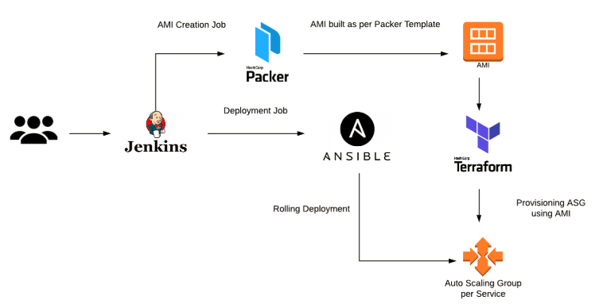
Packer with other tools

Slide 2
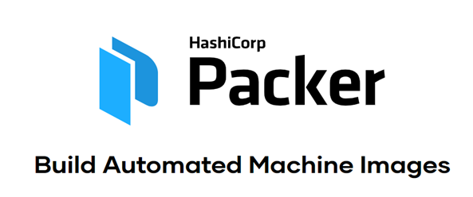
About Packer
Packer Template *.json file
Packer Architecture
Packer with Clouds providers
Packer with other tools
Agenda

Slide 3
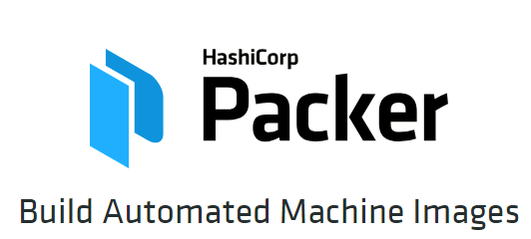
About Packer
Notes:
Hello and welcome to this course, Hands-on Packer, where we're going to learn and get our hands dirty about Build automated machine images in AWS using the open source software, Packer. Throughout this course we'll be showing you the concepts and fundamentals of the software, along with real world examples and exercises on doing many AMI related tasks. My name is Vinod kumar, and in this module we'll be introducing packer, what it can do, and why you'd want to use it.
Packer is an open source tool for creating identical machine images for multiple platforms from a single source configuration. Packer is lightweight, runs on every major operating system, and is highly performant, creating machine images for multiple platforms in parallel. Packer does not replace configuration management like Chef or Puppet. In fact, when building images, Packer is able to use tools like Chef or Puppet to install software onto the image.
A machine image is a single static unit that contains a pre-configured operating system and installed software which is used to quickly create new running machines. Machine image formats change for each platform. Some examples include AMIs for EC2, VMDK/VMX files for VMware, OVF exports for VirtualBox, etc.

Slide 4
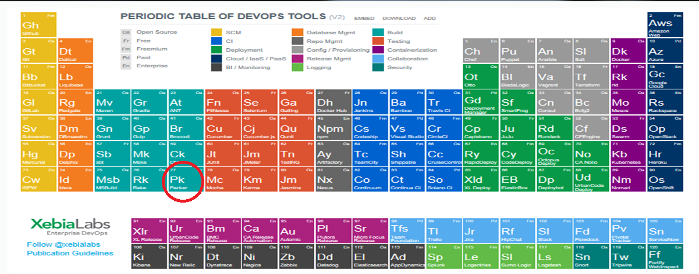
Packer in XebiaLabs

Slide 5
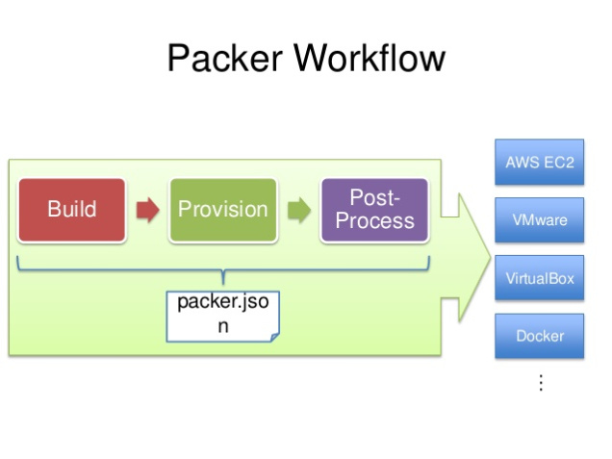
Packer details

Slide 6
Packer details
{
"variables": {
"aws_access_key": "aws_access_key”,
"aws_secret_key": "aws_secret_key"
},
"builders": [{
}],
"provisioners": [
],
"post-processors": ["vagrant"]
}
*.json

Slide 7
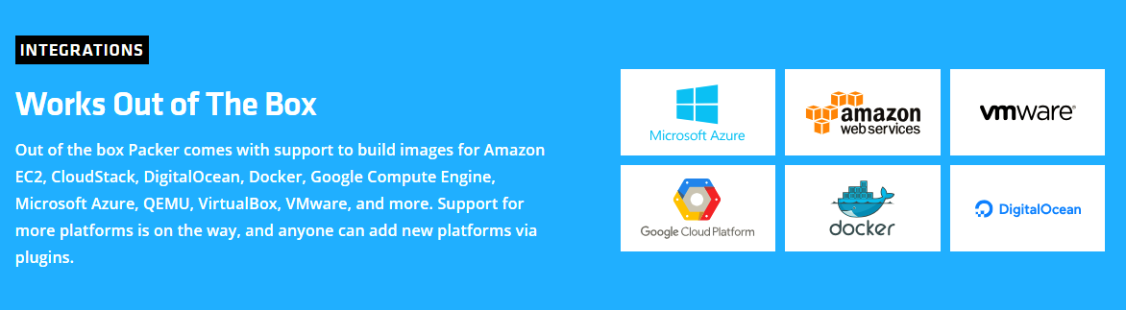
Packer Integration

Slide 8
Packer with other tools

Slide 9
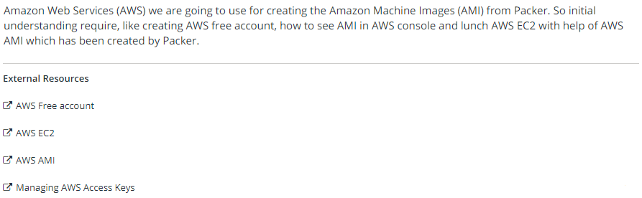
AWS & Packer

Slide 10
About Packer
Packer Template *.json file
Packer Architecture
Packer with Clouds providers
Packer with other tools
Summary

